Slide 1
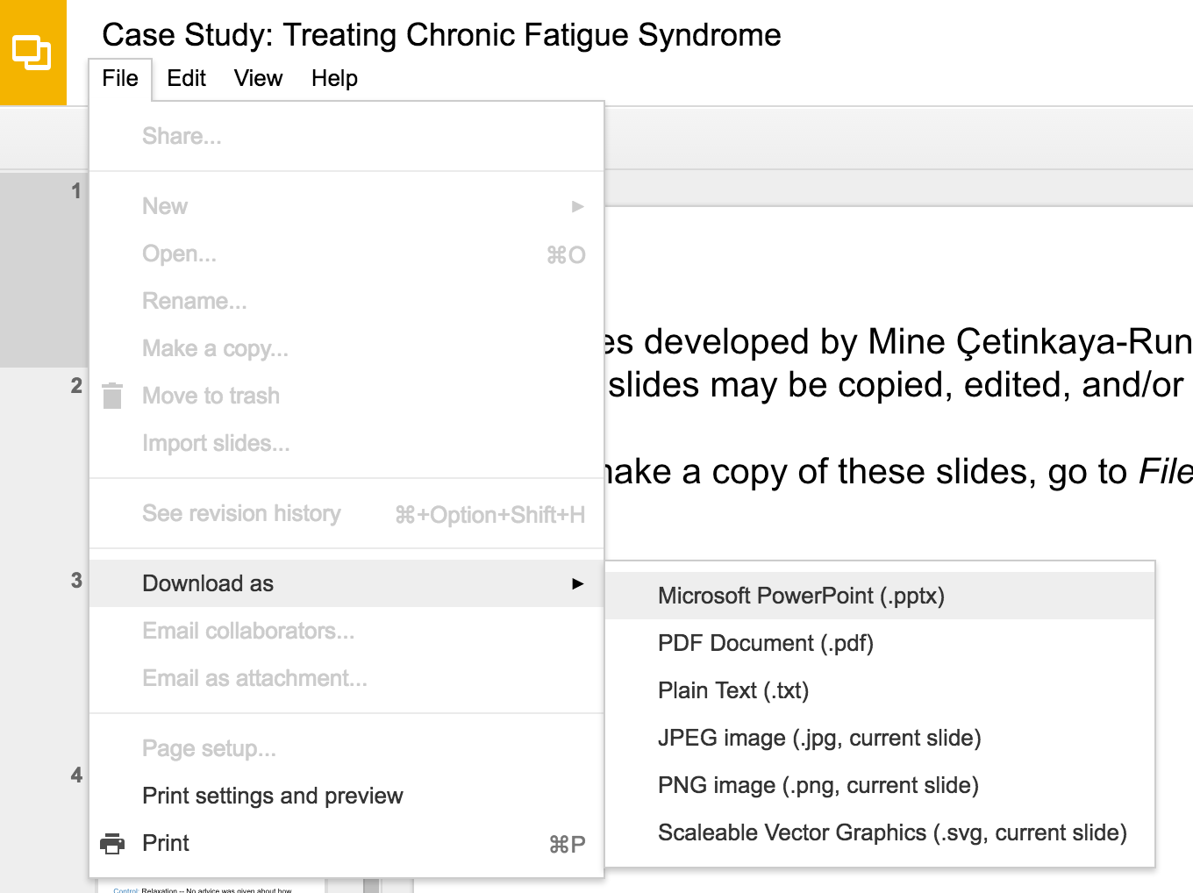
Slides developed by Mine Çetinkaya-Rundel of OpenIntro.
Translated from LaTeX to Google Slides by Curry W. Hilton of OpenIntro.
The slides may be copied, edited, and/or shared via the CC BY-SA license
To make a copy of these slides, go to File > Download as > [option], as shown below. Or if you are logged into a Google account, you can choose Make a copy... to create your own version in Google Drive.

Slide 2
Case Study:
Treating Chronic Fatigue Syndrome

Slide 3
Treating Chronic Fatigue Syndrome
Objective. Evaluate the effectiveness of cognitive-behavior therapy for chronic fatigue syndrome.
Participant pool. 142 patients who were recruited from referrals by primary care physicians and consultants to a hospital clinic specializing in chronic fatigue syndrome.
Actual participants. Only 60 of the 142 referred patients entered the study. Some were excluded because they didn't meet the diagnostic criteria, some had other health issues, and some refused to be a part of the study.
Deale, et. al. 1997. Cognitive behavior therapy for chronic fatigue syndrome: A randomized controlled trial. The American Journal of Psychiatry 154:3.

Slide 4
Study design
Patients randomly assigned to treatment and control groups, 30 patients in each group:
Treatment: Cognitive behavior therapy -- collaborative, educative, and with a behavioral emphasis. Patients were shown on how activity could be increased steadily and safely without exacerbating symptoms.
Control: Relaxation -- No advice was given about how activity could be increased. Instead progressive muscle relaxation, visualization, and rapid relaxation skills were taught.

Slide 5
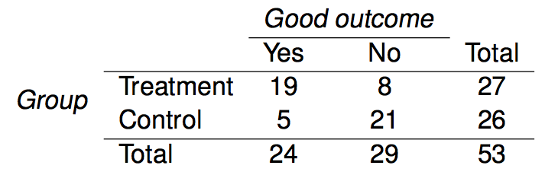
Results
The table below shows the distribution of patients with good outcomes at 6-month follow-up. Note that 7 patients dropped out of the study: 3 from the treatment and 4 from the control group.
 |  | Good Outcome
 |  | Yes | No | Total
Group | Treatment | 19 | 8 | 27
 | Control | 5 | 21 | 26
 | Total | 24 | 29 | 53

Slide 6
Results
The table below shows the distribution of patients with good outcomes at 6-month follow-up. Note that 7 patients dropped out of the study: 3 from the treatment and 4 from the control group.
Proportion with good outcomes
Treatment Group: 19/27 ≈ 0.70 → 70%
 |  | Good Outcome
 |  | Yes | No | Total
Group | Treatment | 19 | 8 | 27
 | Control | 5 | 21 | 26
 | Total | 24 | 29 | 53

Slide 7
Results
The table below shows the distribution of patients with good outcomes at 6-month follow-up. Note that 7 patients dropped out of the study: 3 from the treatment and 4 from the control group.
Proportion with good outcomes in treatment group
19/27 ≈ 0.70 → 70%
Proportion with good outcomes in control group
5/26 ≈ 0.19 → 19%
 |  | Good Outcome
 |  | Yes | No | Total
Group | Treatment | 19 | 8 | 27
 | Control | 5 | 21 | 26
 | Total | 24 | 29 | 53

Slide 8
Understanding the results
Do the data show a "real" difference between the groups?

Slide 9
Understanding the results
Do the data show a "real" difference between the groups?
Suppose you flip a coin 100 times. While the chance a coin lands heads in any given coin flip is 50%, we probably won't observe exactly 50 heads. This type of fluctuation is part of almost any type of data generating process.
The observed difference between the two groups (70 - 19 = 51%) may be real, or may be due to natural variation.
Since the difference is quite large, it is more believable that the difference is real.
We use statistical tools to determine if the difference is so large that we should reject the notion that it was due to chance.

Slide 10
Generalizing the results
Are the results of this study generalizable to all patients with chronic fatigue syndrome?

Slide 11
Generalizing the results
Are the results of this study generalizable to all patients with chronic fatigue syndrome?
These patients had specific characteristics and volunteered to be a part of this study, therefore they may not be representative of all patients with chronic fatigue syndrome. While we cannot immediately generalize the results to all patients, this first study is encouraging. The method works for patients with some narrow set of characteristics, and that gives hope that it will work, at least to some degree, with other patients

Slide 12
Find more resources at openintro.org/os, including
Slides
Videos
Statistical Software Labs
Discussion Forums (free support for students and teachers)
Learning Objectives
Teachers only content is also available for Verified Teachers, including
Exercise solutions
Sample exams
Ability to request a free desk copy for a course
Statistics Teachers email group
Questions? Contact us.

